Slide 1

Deep Learning-Based Object Detection and Tracking System for Automatic Accident Detection in Tunnel CCTV Surveillance
Om Savalaram Jangam
Guide - Ms. Ankita S. Bonde
Seminar
PES Modern College of Engineering Department of Computer Engineering Savitribai Phule Pune University
12-September-2025
Object Detection And Tracking

Slide 2





Outline
Introduction
Literature survey
Objectives and Scope
Problem Statement
ArchitecturalDiagram
Algorithmic Approach
Input / Data sets
Results/Experimental Work Conclusion / Summary
References
1
2
3
4
5
6
6
7
8
9
7
9
Dept of Comp Engg
Short Title
12-September-2025
Object Detection And Tracking

Slide 3

Introduction
Object Detection:
Object detection identifies objects in an image and locates them using bounding boxes. It outputs class labels and coordinates of each object and can detect multiple objects of different classes in a single image. Common algorithms used are YOLO, GNN, and Faster R-CNN, and it finds applications in autonomous driving, surveillance, and face detection. Since it only predicts bounding boxes and not every pixel, it is faster than pixel-level segmentation. Its performance is typically measured using mean Average Precision (mAP).
Fig. Object Detection
Dept of Comp Engg
Short Title
12-September-2025
3 / 11
Object Detection And Tracking

Slide 4

Introduction
Alternative : Image Segmentation
Image segmentation is also a computer vision task that detects known objects along with their precise location. Instead of relying on bounding boxes, it returns a mask that specifies which pixels in the image belong to each object. This approach divides an image into regions or segments based on pixel characteristics and provides pixel-level classification rather than just bounding boxes. Common algorithms for image segmentation include U-Net, Mask R-CNN, and Deep-Lab. It is widely used in applications such as medical imaging, scene understanding, and augmented reality. However, it is generally more computationally intensive than object detection because it requires analyzing every pixel in the image.
Fig. Image segmentation
Dept of Comp Engg
Short Title
12-September-2025
4 / 11
Object Detection And Tracking

Slide 5
Introduction
Convolutional Neural Networks (CNNs):
CNN are deep learning models that automatically extract spatial features from images, making them more effective than multilayer perceptrons (MLPs) for tasks like classification, detection, and recognition. They can efficiently learn visual patterns such as edges, shapes, and objects, enabling accurate identification and localization of events like wrong-way driving, vehicle stoppage, pedestrian intrusion, or fire in tunnels, which helps prevent collisions, reduce damage, save lives, and ensure timely responses by authorities to avoid future accidents.
Dept of Comp Engg
Short Title
12-September-2025
5 / 11
Object Detection And Tracking

Slide 6
Literature Survey(1/4)
Title | Author, Year, Publication | Approach | Remark
Automatic Detection of Foreign Object Debris on Runways | Dr. Rajeswari , 2025, International Journal for Research in Applied Science and Engineering Technology. | FOD detection framework using YOLO Model. | This paper presents a practical computer vision–based FOD detection framework using unmanned aerial systems and YOLO models, effectively addressing the limitations of accuracy and timeliness in traditional runway inspection methods. It contributes to enhancing aviation safety by enabling faster and more reliable foreign object detection and removal.
Table 1:-Literature Survey
Dept of Comp Engg
Short Title
12-September-2025
6 / 11
Object Detection And Tracking

Slide 7
Literature Survey(2/4)
Title | Author, Year, Publication | Approach | Remark
3D Object Detection and Tracking Methods using Deep Learning for Computer Vision Applications | Shreyas E, Manav Hiren Sheth and Mohana, 2021, 6th International Conference on Recent Trends on Electronics, Information, Communication & Technology (RTEICT) | Graph Neural Network (GNN) | Insights into advanced 3D object detection and tracking methods, highlighting their importance in enhancing depth perception and decision-making for critical applications such as autonomous driving, robotics, and augmented reality
Table 2:-Literature Survey
Dept of Comp Engg
Short Title
12-September-2025
7 / 11
Object Detection And Tracking

Slide 8
Literature Survey(2/4)
Title | Author, Year, Publication | Approach | Remark
Review of deep learning: concepts, CNN architectures, challenges, applications, future directions | Laith Alzubaidi1,5* , Jinglan Zhang1, Amjad J. Humaidi2, Ayad Al‑Dujaili3, Ye Duan4, Omran Al‑Shamma5, J. Santamaría6, Mohammed A. Fadhel7, Muthana Al‑Amidie4 and Laith Farhan8 , 2021, Queensland University of Technology and the University of Information Technology and Communications | CNN ( Convolution Neural Network) | Object detection locates and classifies objects in an image using bounding boxes, making it fast and suitable for tasks like surveillance, face detection, and autonomous driving. Image segmentation classifies each pixel in an image to provide more detailed region-based understanding, useful in applications like medical imaging, AR, and scene analysis.
Table 2:-Literature Survey
Dept of Comp Engg
Short Title
12-September-2025
8 / 11
Object Detection And Tracking

Slide 9
Literature Survey(4/4)
Title | Author, Year, Publication | Approach | Remark
An application of a deep learning algorithm for automatic detection of unexpected accidents under bad CCTV monitoring conditions in tunnels | Kyu Beom Lee and Hyu Soung Shin, 2019, International Conference on Deep Learning and Machine Learning in Emerging Applications (Deep-ML) | Faster R-CNN (Regional Convolution Neural Network) | The deep learning model in ODTS will be trained on a dataset of tunnel event images, enabling it to learn patterns effectively and enhance the accuracy of accident prediction
Object Detection and Count of Objects in Image using Tensor Flow Object Detection API | B N Krishna Sai And Sasikala T. , 2019, International Conference on Smart Systems and Inventive Technology (ICSSIT) | Tensor Flow Object Detection API and Faster R-CNN | demonstrates the use of TensorFlow’s Object Detection API with Faster R-CNN to effectively detect and classify threatening objects, showcasing its potential in enhancing safety and security applications.
Table 1:-Literature Survey
Dept of Comp Engg
Short Title
12-September-2025
9 / 11
Object Detection And Tracking

Slide 10
Objectives
To ensure scalability and adaptability so that detection accuracy
improves as the training dataset grows richer.
To reduce dependency on manual CCTV monitoring and minimize
human error in accident detection.
To develop an AI-powered accident detection system using
deep learning techniques.
To apply Convolutional Neural Networks (CNNs) for detecting objects
such as vehicles, pedestrians, and fire in tunnel CCTV footage.
Dept of Comp Engg
Short Title
12-September-2025
10 / 11
Object Detection And Tracking

Slide 11
scope
Detects accident-prone events: wrong-way driving, stoppage, pedestrian presence, and fire.
Applicable in tunnels, highways, and critical traffic zones with CCTV.
Uses CNN, Faster R-CNN, and tracking algorithms for real-time detection.
Accuracy improves as dataset grows with diverse scenarios.
Reduces manual monitoring and minimizes human errors.
Dept of Comp Engg
Short Title
12-September-2025
11 / 11
Object Detection And Tracking

Slide 12
Problem Statement
“Accidents occurring inside tunnels are difficult to detect in real time due to poor visibility, reliance on manual monitoring, and lack of automated surveillance intelligence. To overcome these limitations, an Object Detection and Tracking System is required to identify accident-related scenarios automatically using deep learning models integrated with CCTV systems.”
Dept of Comp Engg
Short Title
12-September-2025
12 / 11
Object Detection And Tracking

Slide 13
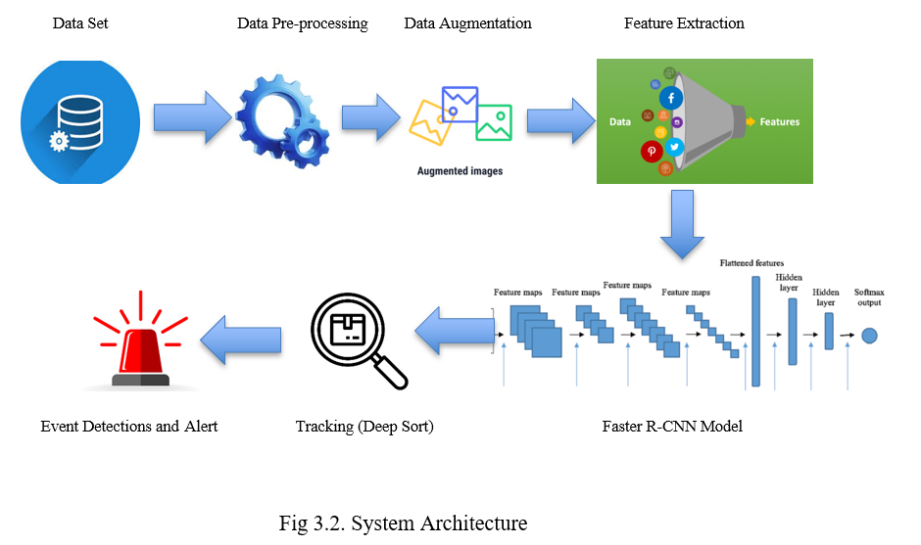
Architecture Diagram
Dept of Comp Engg
Short Title
12-September-2025
13 / 11
Object Detection And Tracking

Slide 14
Algorithm Approach
1. Load video stream V
2. For each frame Ft in V:
a. Pre-process Ft (resize, normalize, denoise)
b. Apply data augmentation (optional for training)
c. Detect objects using Faster R-CNN → get bounding boxes B
d. Track objects using Deep SORT/Kalman Filter → assign unique IDs
e. For each object O in B:
i. If O.class == Vehicle:
- If moving opposite to tunnel flow →
Event = WrongWayDriving
- If speed ≈ 0 for duration > Ts →
Event = VehicleStoppage
ii. If O.class == Person and in restricted zone →
Event = PedestrianIntrusion
iii. If O.class == Fire/Smoke with confidence > θ →
Event = FireIncident
f. Send detected Event(s) to control centre alert system
3. Repeat for all frames
Dept of Comp Engg
Short Title
12-September-2025
14 / 11
Object Detection And Tracking

Slide 15
Input and Data sets
Wrong-Way Driving: Combination of real tunnel videos and samples.
Vehicle Stoppage: Recordings of vehicles stopped in tunnels.
Pedestrian Intrusion: Simulated tunnel entries with actors.
Fire Incidents: Public fire datasets with simulated tunnel fire clips.
Dataset split:
70% Training
15% Validation
15% Testing
This dataset ensures that the model can detect all relevant safety-critical scenarios in tunnels
Dept of Comp Engg
Short Title
12-September-2025
15 / 11
Object Detection And Tracking

Slide 16
Conclusion
The ODTS uses Faster R-CNN for detection and DeepSORT for tracking to identify tunnel accidents (wrong-way driving, stoppage, pedestrian intrusion, fire) with real-time monitoring and alerts.
It minimizes reliance on manual surveillance, is scalable across tunnels or traffic environments, and significantly enhances safety by supporting proactive accident prevention.
Dept of Comp Engg
Short Title
12-September-2025
16 / 11
Object Detection And Tracking

Slide 17
References
[1].E. S. Lee, W. Choi, D. Kum, “Bird’s eye view localization of surrounding vehicles :Longitudinaland lateral distance estimation with partial appearance,” Robotics and Autonomous Systems, 2019, vol. 112, pp. 178-189.
[2] L. Cao, Q. Jiang, M. Cheng, C. Wang, “Robust vehicle detection by combining deep features with exemplar Neurocomputing, 2016, vol. 215, pp. 225-231. classification,”
[3].Alzubaidi, L., Zhang, J., Humaidi, A.J. et al. Review of deep learning: concepts, CNN architectures,
challenges, applications, future directions. J Big Data 8, 53 (2021).
Dept of Comp Engg
Short Title
12-September-2025
17 / 11
Object Detection And Tracking

Slide 18

Short Title

